Slide 1
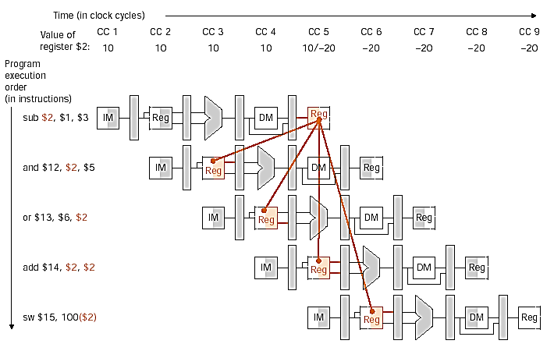
Data Hazards & forwarding

Slide 2
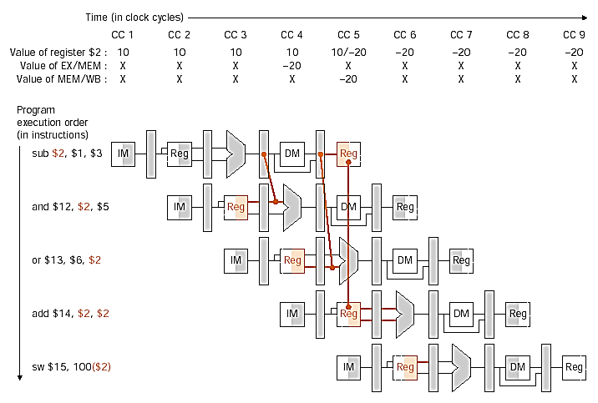
Forwarding Data

Slide 3
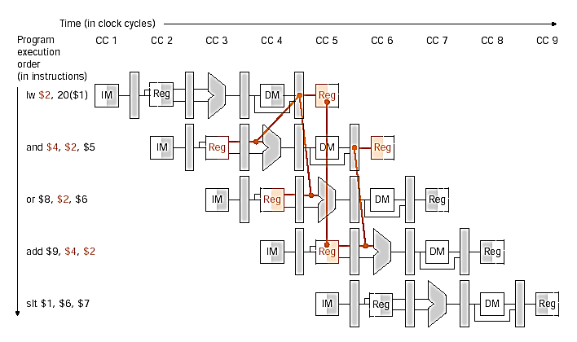
Data Hazards and Stalls

Slide 4
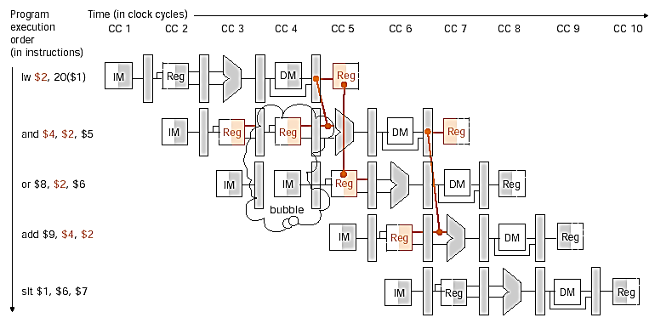
Data Hazard and Stall

Slide 5
Control Hazards
Mary Jane Irwin
[Adapted from Computer Organization and Design,
Patterson & Hennessy, © 2005, UCB]
Notes:
Other handouts
To handout next time

Slide 6
Review: Datapath with Data Hazard Control
PCSrc
Hazard
Unit
ID/EX
ID/EX.MemRead
IF/ID.Write
EX/MEM
PC.Write
0
IF/ID
1
Control
0
Add
MEM/WB
Add
Branch
4
Shift
left 2
Instruction
Memory
Read Addr 1
Data
Memory
Register
File
Read
Data 1
Read Addr 2
PC
Read
Address
Read
Data
Write Addr
ALU
Address
Read
Data 2
Write Data
Write Data
ALU
cntrl
16
Sign
Extend
32
Forward
Unit
ID/EX.RegisterRt

Slide 7
Control Hazards
When the flow of instruction addresses is not sequential (i.e., PC = PC + 4); incurred by change of flow instructions
  Conditional branches (beq, bne)
  Unconditional branches (j, jal, jr)
  Exceptions
Possible approaches
  Stall (impacts CPI)
  Move decision point as early in the pipeline as possible, thereby reducing the number of stall cycles
  Delay decision (requires compiler support)
  Predict and hope for the best !
Control hazards occur less frequently than data hazards, but there is nothing as effective against control hazards as forwarding is for data hazards

Slide 8
Datapath Branch and Jump Hardware
ID/EX
EX/MEM
IF/ID
Control
Add
MEM/WB
4
Instruction
Memory
Read Addr 1
Data
Memory
Register
File
Read
Data 1
Read Addr 2
PC
Read
Address
Read
Data
Write Addr
ALU
Address
Read
Data 2
Write Data
Write Data
ALU
cntrl
16
Sign
Extend
32
Forward
Unit
Notes:
For class handout

Slide 9
Datapath Branch and Jump Hardware
Jump
PCSrc
Shift
left 2
ID/EX
EX/MEM
IF/ID
Control
Add
MEM/WB
PC+4[31-28]
Add
Branch
4
Shift
left 2
Instruction
Memory
Read Addr 1
Data
Memory
Register
File
Read
Data 1
Read Addr 2
PC
Read
Address
Read
Data
Write Addr
ALU
Address
Read
Data 2
Write Data
Write Data
ALU
cntrl
16
Sign
Extend
32
Forward
Unit
Notes:
For lecture

Slide 10
Jumps Incur One Stall
Jumps not decoded until ID, so one flush is needed
Fix jump hazard by waiting – stall – but affects CPI
I
n
s
t
r.
O
r
d
e
r
j
IM
Reg
ALU
DM
Reg
flush
IM
Reg
ALU
DM
Reg
j target
IM
Reg
ALU
DM
Reg
Fortunately, jumps are very infrequent – only 3% of the SPECint instruction mix
Notes:
Fortunately, jumps are very infrequent – less that 2% of the SPECint instructions and x% of the SPECfp ones.

Slide 11
Supporting ID Stage Jumps
Jump
PCSrc
Shift
left 2
ID/EX
EX/MEM
IF/ID
Control
Add
MEM/WB
PC+4[31-28]
Add
Branch
4
Shift
left 2
Instruction
Memory
Read Addr 1
Data
Memory
Register
File
Read
Data 1
0
Read Addr 2
PC
Read
Address
Read
Data
Write Addr
ALU
Address
Read
Data 2
Write Data
Write Data
ALU
cntrl
16
Sign
Extend
32
Forward
Unit
Notes:
For lecture

Slide 12
Review: Branches Incur Three Stalls
I
n
s
t
r.
O
r
d
e
r
beq
IM
Reg
ALU
DM
Reg
Fix branch hazard by waiting – stall – but affects CPI
flush
flush
flush
beq target
IM
Reg
ALU
DM
Reg
Notes:
Another “solution” is to put in enough extra hardware so that we can test registers, calculate the branch address, and update the PC during the second stage of the pipeline. That would reduce the number of stalls to only one.
A third approach is to prediction to handle branches, e.g., always predict that branches will be untaken. When right, the pipeline proceeds at full speed. When wrong, have to stall (and make sure nothing completes – changes machine state – that shouldn’t have). Will talk about these options in more detail in next,next lecture.

Slide 13
Moving Branch Decisions Earlier in Pipe
Move the branch decision hardware back to the EX stage
  Reduces the number of stall (flush) cycles to two
  Adds an and gate and a 2x1 mux to the EX timing path
Add hardware to compute the branch target address and evaluate the branch decision to the ID stage
  Reduces the number of stall (flush) cycles to one (like with jumps)
    But now need to add forwarding hardware in ID stage
  Computing branch target address can be done in parallel with RegFile read (done for all instructions – only used when needed)
  Comparing the registers can’t be done until after RegFile read, so comparing and updating the PC adds a mux, a comparator, and an and gate to the ID timing path
For deeper pipelines, branch decision points can be even later in the pipeline, incurring more stalls
Notes:
Want a small branch penalty.
Need more forwarding and hazard detection hardware for second option (one stall implementation) since a branch depended on a result still in the pipeline (that is one of the source operands for the comparison logic) must be forwarded from the EX/MEM or MEM/WB pipeline latches.

Slide 14
Delayed Decision
If the branch hardware has been moved to the ID stage, then we can eliminate all branch stalls with delayed branches which are defined as always executing the next sequential instruction after the branch instruction – the branch takes effect after that next instruction
  MIPS compiler moves an instruction to immediately after the branch that is not affected by the branch (a safe instruction) thereby hiding the branch delay
With deeper pipelines, the branch delay grows requiring more than one delay slot
  Delayed branches have lost popularity compared to more expensive but more flexible (dynamic) hardware branch prediction
  Growth in available transistors has made hardware branch prediction relatively cheaper
Notes:
No processor uses delayed branches of more than 1 cycl.
For longer branch delays, hardware-base branch prediction is used.

Slide 15
Scheduling Branch Delay Slots
A. From before branch
B. From branch target
C. From fall through
add $1,$2,$3
if $2=0 then
sub $4,$5,$6
add $1,$2,$3
if $1=0 then
delay slot
delay slot
add $1,$2,$3
if $1=0 then
delay slot
sub $4,$5,$6
becomes
becomes
becomes
if $2=0 then
add $1,$2,$3
if $1=0 then
add $1,$2,$3
sub $4,$5,$6
add $1,$2,$3
if $1=0 then
sub $4,$5,$6
A is the best choice, fills delay slot and reduces IC
In B and C, the sub instruction may need to be copied, increasing IC
In B and C, must be okay to execute sub when branch fails
Notes:
Limitations on delayed-branch scheduling come from 1) restrictions on the instructions that can be moved/copied into the delay slot and 2) limited ability to predict at compile time whether a branch is likely to be taken or not.
In B and C, the use of $1 prevents the add instruction from being moved to the delay slot
In B the sub may need to be copied because it could be reached by another path. B is preferred when the branch is taken with high probability (such as loop branches

Slide 16
Static Branch Prediction
Resolve branch hazards by assuming a given outcome and proceeding without waiting to see the actual branch outcome
Predict not taken – always predict branches will not be taken, continue to fetch from the sequential instruction stream, only when branch is taken does the pipeline stall
  If taken, flush instructions after the branch (earlier in the pipeline)
    in IF, ID, and EX stages if branch logic in MEM – three stalls
    In IF and ID stages if branch logic in EX – two stalls
    in IF stage if branch logic in ID – one stall
  ensure that those flushed instructions haven’t changed the machine state – automatic in the MIPS pipeline since machine state changing operations are at the tail end of the pipeline (MemWrite (in MEM) or RegWrite (in WB))
  restart the pipeline at the branch destination
Notes:
This is a static scheme since the same decision is always made (not taken or taken).
This is just what we have already illustrated!

Slide 17
Flushing with Misprediction (Not Taken)
4 beq $1,$2,2
IM
Reg
ALU
DM
Reg
I
n
s
t
r.
O
r
d
e
r
8 sub $4,$1,$5
IM
Reg
ALU
DM
Reg
To flush the IF stage instruction, assert IF.Flush to zero the instruction field of the IF/ID pipeline register (transforming it into a noop)
Notes:
For class handout

Slide 18
Flushing with Misprediction (Not Taken)
4 beq $1,$2,2
IM
Reg
ALU
DM
Reg
I
n
s
t
r.
O
r
d
e
r
8 sub $4,$1,$5
IM
Reg
DM
Reg
flush
ALU
16 and $6,$1,$7
IM
Reg
ALU
DM
Reg
20 or r8,$1,$9
IM
Reg
ALU
DM
Reg
To flush the IF stage instruction, assert IF.Flush to zero the instruction field of the IF/ID pipeline register (transforming it into a noop)
Notes:
For lecture
Note branch address is PC-relative branch to 4+4+2*4 = 16

Slide 19
Branching Structures
Predict not taken works well for “top of the loop” branching structures
Loop: beq $1,$2,Out
1nd loop instr
.
.
.
last loop instr
j Loop
Out: fall out instr
  But such loops have jumps at the bottom of the loop to return to the top of the loop – and incur the jump stall overhead
Predict not taken doesn’t work well for “bottom of the loop” branching structures
Loop: 1st loop instr
2nd loop instr
.
.
.
last loop instr
bne $1,$2,Loop
fall out instr

Slide 20
Static Branch Prediction, con’t
Resolve branch hazards by assuming a given outcome and proceeding
Predict taken – predict branches will always be taken
  Predict taken always incurs one stall cycle (if branch destination hardware has been moved to the ID stage)
  Is there a way to “cache” the address of the branch target instruction ??
As the branch penalty increases (for deeper pipelines), a simple static prediction scheme will hurt performance. With more hardware, it is possible to try to predict branch behavior dynamically during program execution
Dynamic branch prediction – predict branches at run-time using run-time information
Notes:
Predict taken always incurs one stall at least – assuming the branch destination address hardware has been moved up to the ID stage.
So predict not taken is easier since sequential instruction address can be computed in the IF stage.

Slide 21
Dynamic Branch Prediction
A branch prediction buffer (aka branch history table (BHT)) in the IF stage addressed by the lower bits of the PC, contains a bit passed to the ID stage through the IF/ID pipeline register that tells whether the branch was taken the last time it was execute
  Prediction bit may predict incorrectly (may be a wrong prediction for this branch this iteration or may be from a different branch with the same low order PC bits) but the doesn’t affect correctness, just performance
    Branch decision occurs in the ID stage after determining that the fetched instruction is a branch and checking the prediction bit
  If the prediction is wrong, flush the incorrect instruction(s) in pipeline, restart the pipeline with the right instruction, and invert the prediction bit
    A 4096 bit BHT varies from 1% misprediction (nasa7, tomcatv) to 18% (eqntott)
Notes:
4096 entry table programs vary from 1% misprediction (nasa7, tomcatv) to 18% (eqntott), with spice at 9% and gcc at 12%
4096 about as good as infinite table, but 4096 is a lot of hardware

Slide 22
Branch Target Buffer
The BHT predicts when a branch is taken, but does not tell where its taken to!
  A branch target buffer (BTB) in the IF stage can cache the branch target address, but we also need to fetch the next sequential instruction. The prediction bit in IF/ID selects which “next” instruction will be loaded into IF/ID at the next clock edge
    Would need a two read port instruction memory
BTB
  Or the BTB can cache the branch taken instruction while the instruction memory is fetching the next sequential instruction
Instruction
Memory
PC
Read
Address
0
If the prediction is correct, stalls can be avoided no matter which direction they go
Notes:
Except for the first time the branch is encountered, when we don’t have the branch instruction loaded into the BTB
Its not quite this simple – what if the BTB instruction is for the wrong branch!! – but close enough for students at this level

Slide 23
1-bit Prediction Accuracy
A 1-bit predictor will be incorrect twice when not taken
  Assume predict_bit = 0 to start (indicating branch not taken) and loop control is at the bottom of the loop code
  First time through the loop, the predictor mispredicts the branch since the branch is taken back to the top of the loop; invert prediction bit (predict_bit = 1)
  As long as branch is taken (looping), prediction is correct
  Exiting the loop, the predictor again mispredicts the branch since this time the branch is not taken falling out of the loop; invert prediction bit (predict_bit = 0)
Loop: 1st loop instr
2nd loop instr
.
.
.
last loop instr
bne $1,$2,Loop
fall out instr
For 10 times through the loop we have a 80% prediction accuracy for a branch that is taken 90% of the time

Slide 24
2-bit Predictors
A 2-bit scheme can give 90% accuracy since a prediction must be wrong twice before the prediction bit is changed
Loop: 1st loop instr
2nd loop instr
.
.
.
last loop instr
bne $1,$2,Loop
fall out instr
Taken
Not taken
Predict
Taken
Predict
Taken
Taken
Taken
Not taken
Not taken
Predict
Not Taken
Predict
Not Taken
Taken
Not taken
Notes:
For class handout

Slide 25
2-bit Predictors
A 2-bit scheme can give 90% accuracy since a prediction must be wrong twice before the prediction bit is changed
right 9 times
Loop: 1st loop instr
2nd loop instr
.
.
.
last loop instr
bne $1,$2,Loop
fall out instr
wrong on loop fall out
Taken
Not taken
1
1
Predict
Taken
Predict
Taken
11
10
Taken
right on 1st iteration
Not taken
Taken
Not taken
Predict
Not Taken
0
0
Predict
Not Taken
00
BHT also stores the initial FSM state
01
Taken
Not taken
Notes:
For lecture
In a counter implementation, the counters are incremented when a branch is taken and decremented when not taken (and saturate at 00 or 11). Since we read the prediction bits on every cycle, a 2-bit predictor will need both a read and a write access port (for updating the prediction bits).

